Slide 1
Insights from the Airbnb, NYC Analysis
For Head of Acquisition & Operations and Head of User Experience
Submitted by: Ashish Arora, Suraj Dhamdhere, Abhishek Ranjan

Slide 2
Agenda
Recommendations
Objectives
Background Summary
Important Findings
Conclusion
Appendix - Data Methodology

Slide 3
Recommendations:
Manhattan and Brooklyn should be the place to target.
One to one interaction with some property owners in Staten Island, Queens and Bronx should be made to identify their challenges for being fully functional.
We could acquire listed properties as entire home/apt and private room.
Many properties in Manhattan and Brooklyn is not available now. We can consult these hosts again and can provide monetary assistance in renovation as acquiring new hosts may cost more.
Prices in Manhattan should be re-considered.

Slide 4
Objectives
Improve our shared understanding about our end consumer experience and preferences.
Improve our shared understanding about the challenges and gap faced by the customers hosting their personal space on the platform.
Provide early recommendations to our Head of Acquisitions and Operations to exemplify the smooth equation between both the customers in Airbnb community.

Slide 5
Background Summary
In the last few months, Airbnb has seen a major decline in revenue due to lockdown imposed during pandemic.
Hence provided the information in hand based on previous data captured, we need to analyze the patterns for declining profits and recommend certain suggestions to overcome.
Airbnb NYC has 5 Neighborhood groups and 221 Neighborhoods with 3 different room types.

Slide 6
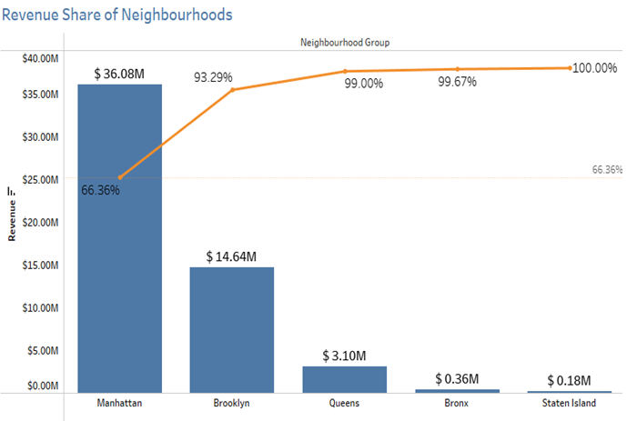
Important Findings
Manhattan is most prominent neighborhood group in New York.
Around 66% of revenue is coming from Manhattan itself followed by Brooklyn which has 23% share in overall revenue.

Slide 7
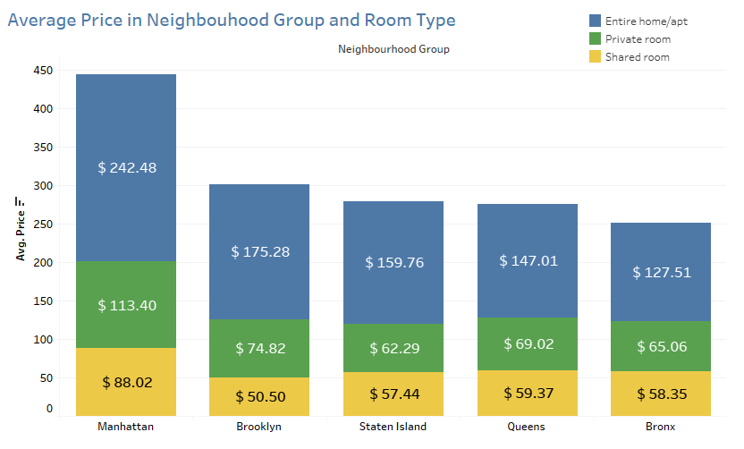
An average price range preferred by a customer is:
Entire Home: 150$ to 120$
Private Room: 70$ to 60$
Shared Room: 50$ to 60$
Whereas the most traction generating neighborhoods i.e. Manhattan and Brooklyn offers a higher price range which might demotivate the customer to book.

Slide 8
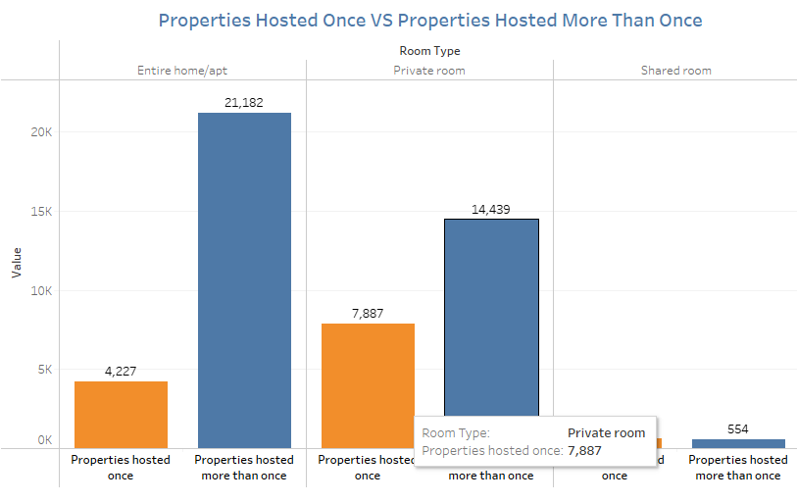
Entire homes are hosted twice or more are 5 time more than it is hosted once which shows they are more likely to get booked again.
Likelihood of Private room getting booked is twice of hosting once.

Slide 9
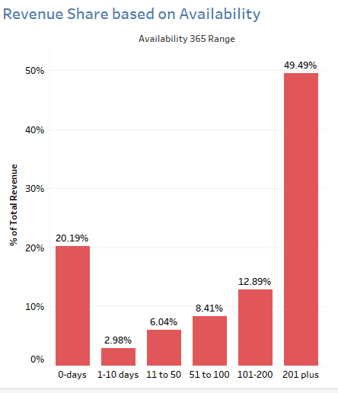
Properties which are available for 201 days or more share almost 50% of Revenue.
Properties which are available for 0 days post Covid-19 contributes 20% to overall revenue.
These properties should be contacted again.
We should make a marketing policy such that it push host to keep its property available for most number of days.

Slide 10
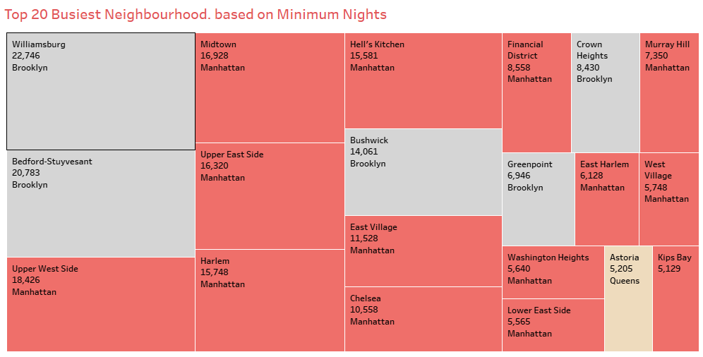
These 20 neighbourhoods hosted most number of nights.
5 of them are from Brooklyn, 14 are from Manhattan and 1 from Queens.

Slide 11
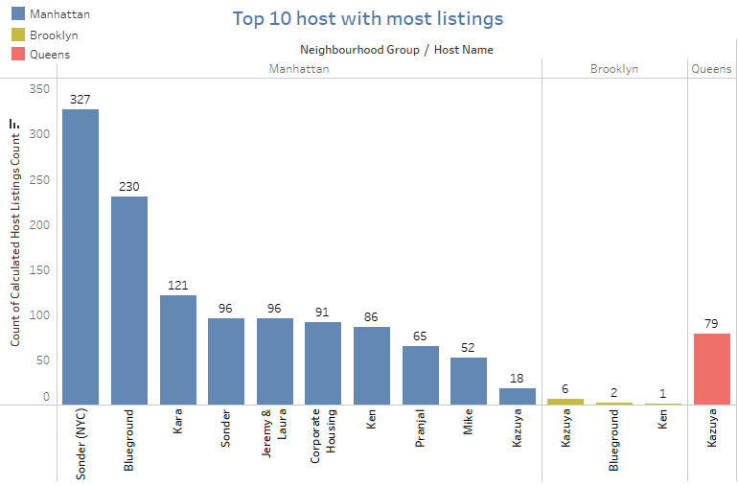
Sonder hosts around 327 properties with us, followed by Blue ground which host 230 properties and so on.
Kazuya, from Queens, also host 79 properties. We should interact with such hosts and introduce them in Marketing ads which may help in acquiring more hosts in neighbourhood.

Slide 12
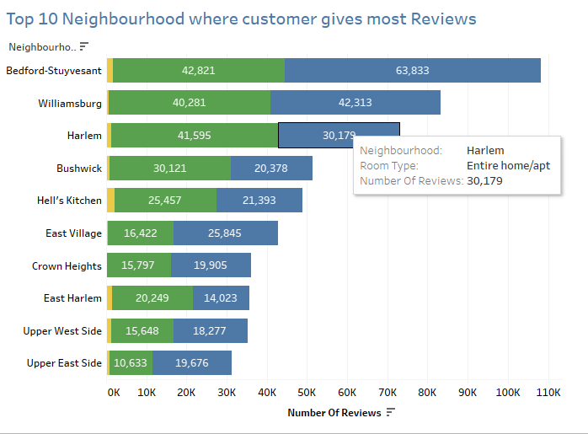
Customers in these 10 neighbourhoods shared most number of reviews.
This could be either because customers are getting problem in these neighbourhood or they are extra active in these neighbourhoods.
Thus we should find a conclusive evidence for them.

Slide 13
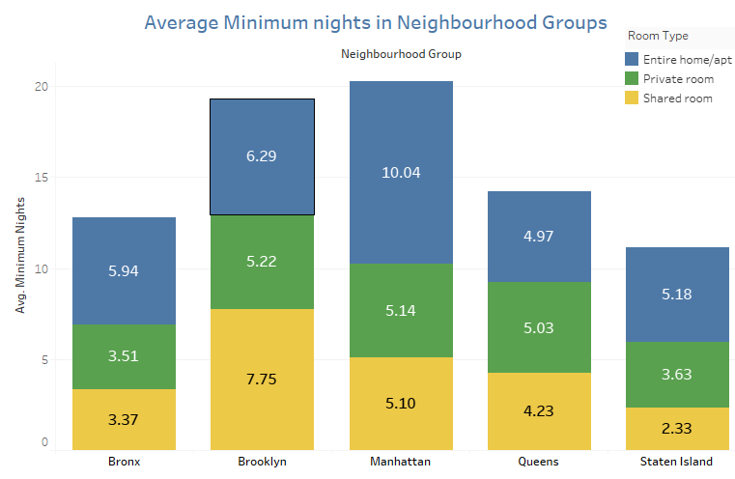
Manhattan on average host minimum 10 nights for entire homes.
Queens, Brooklyn and Manhattan on average host 5 nights for Private Rooms.
Staten Island and Bronx host less nights as compared to others.

Slide 14
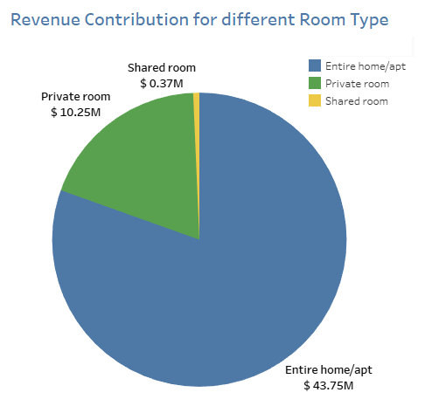
Entire home as so far earned us a functional revenue of 44 millions dollars followed by private rooms with 10 million revenue.
Post Covid-19 it is also evident that people would rarely go for shared rooms.
Better if we keep our focus on acquiring host with Entire home and private rooms.

Slide 15
Conclusion
Price review of properties hosted in Manhattan.
Entire Home contributes to 44 million of Revenue.
Likelihood of Private room getting booked is twice of hosting once and 5 times for entire home.
Properties which are available for 200+ days are more likely to be profitable.
We should interact with hosts who are hosting more than 50 properties and introduce them in Marketing ads which may help in acquiring more hosts in neighbourhood.
Reviews should be through analyzed and sentimental analysis should be done on them.

Slide 16
Appendix – Data Methodology
Methodology Approach
Research Problem
Business Understanding
Type of Data Require – Data Source
Whom are we presenting?
Analysis Done
Recommendations
Analysis Methodology
Data Understanding and Preparation
Variables overview
Handling missing values and outliers
Feature selection / engineering
Analyzing methods
Evaluation of Methods
Finding and Insights
**Note: Please Refer Methodology Document for complete details.

Slide 17
Thank You

